Slide 1
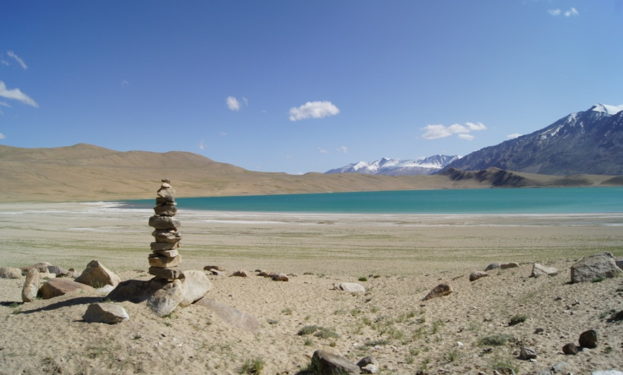
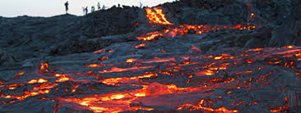
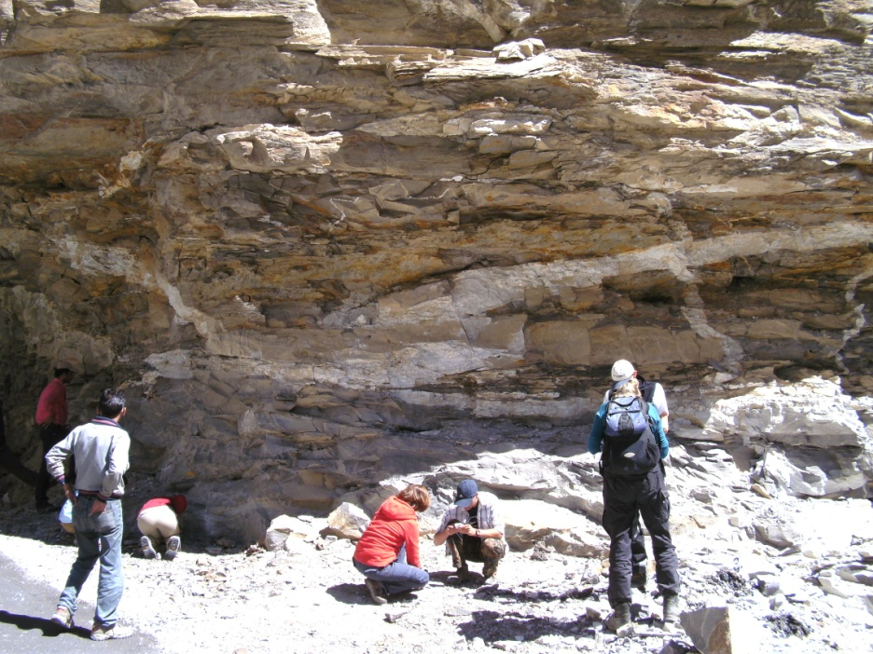
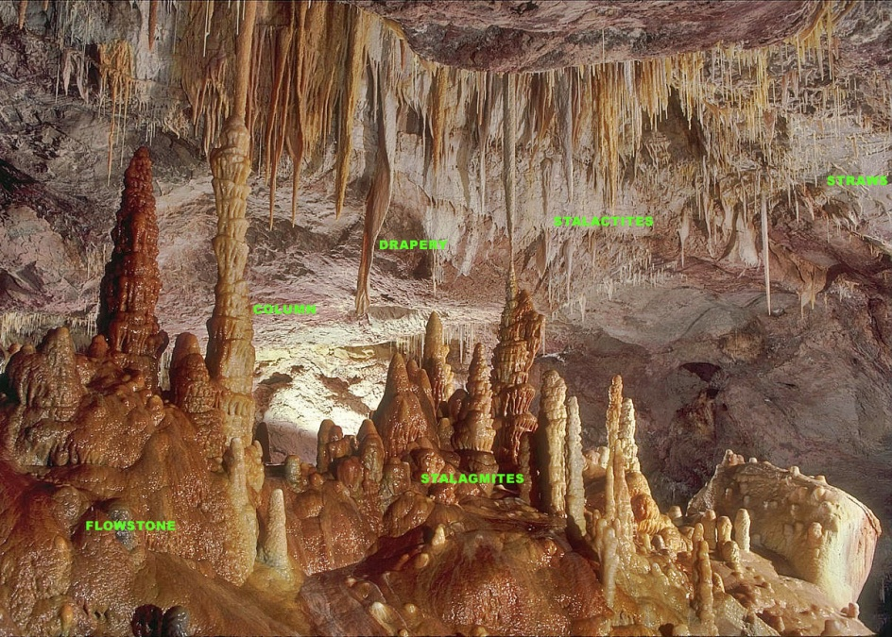
IDC203: IDC:203: Introduction to Earth Sciences

Slide 2
Outline
What are minerals?
The formation of minerals
Classes of rock forming minerals
Physical properties of minerals

Slide 3
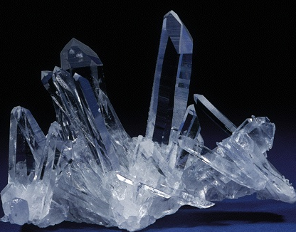
Minerals: building blocks of rocks
Breck P. Kent

Slide 4
Mineral
A naturally occurring, inorganic solid with an ordered internal structure and a narrow range of chemical composition
Mineralogy is the branch of geology that studies composition, stability, occurrence and association of minerals

Slide 5
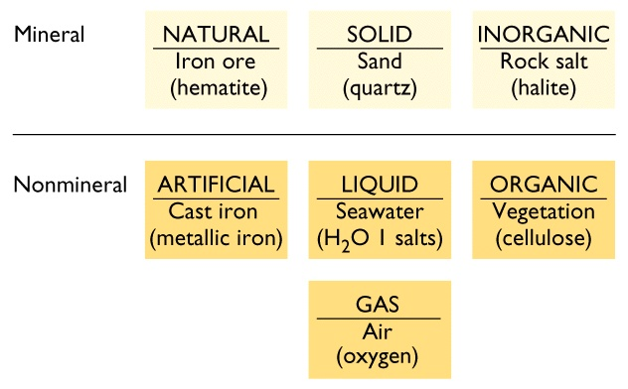
Mineral

Slide 6
Rock
A naturally occurring consolidated mixture of minerals or mineral-like substances

Slide 7
Abundance of the elements (wt. %)
Crust Whole Earth
Oxygen 46.3 % 29.5%
Silicon 28.2% 15.2%
Aluminum 8.2% 1.1%
Iron 5.6% 34.6%
Calcium 4.1% 1.1%
Sodium 2.4% 0.6%
Potassium 2.1% 0.1%
Magnesium 2.3% 12.7%
Titanium 0.5% 0.1%
Nickel trace 2.4%
All others trace 2.7%

Slide 8
Important ions in minerals
anions charge cations charge
O -2
Si +4
K +1
Ca +2
Na +1
Al +3
Mg +2
Fe +2 or +3

Slide 9
Chemical symbols
Oxygen O Magnesium Mg
Silicon Si Iron Fe
Aluminum Al Sodium Na
Potassium K Calcium Ca
Carbon C Titanium Ti
Hydrogen H Argon Ar
Uranium U Zirconium Zr
Strontium Sr Lead Pb

Slide 10
Formation of mineral
Mineral form by the process of the crystallization
Magma crystallizes in to solid materials as it cools
Crystallization can also occur when liquids evaporate from a solution

Slide 11
Classes of mineral forming rocks
There are some 3,500 recognized minerals found on Earth.
For our purpose, we can focus on about a dozen.
Silicates - Si, O and other elements, the most abundant mineral group in the Earth’s crust
Carbonates - Ca, Mg and CO₃
Salts - NaCl

Slide 12
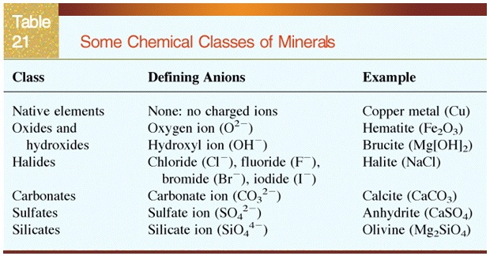
Classes of mineral forming rocks

Slide 13
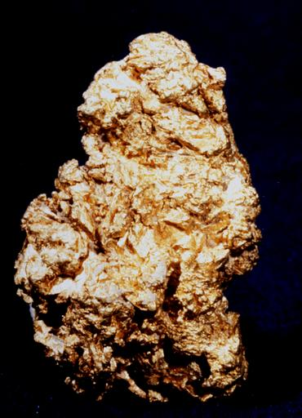
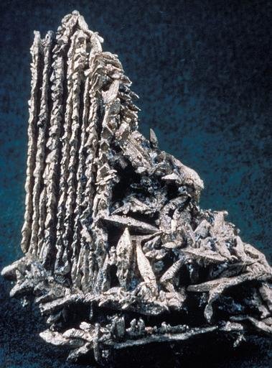
Native elements
Native elements are minerals that are composed of a single element.
Some examples are: Gold (Au), Silver (Ag), Copper (Cu), Iron (Fe), Diamonds (C), Graphite (C), and Platinum (Pt)
Gold
Silver

Slide 14
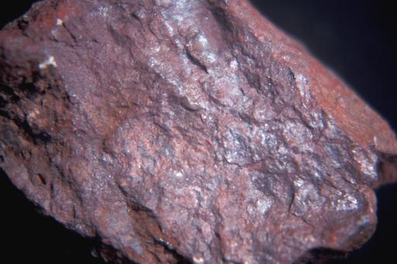
Oxides
Oxides are minerals that include one or more metal cations bonded to oxygen or hydroxyl anions.
Examples of oxide minerals include: Hematite (Fe₂O₃), Magnetite (Fe₃O₄), Corundum (Al₂O₃), and Ice (H₂O)
Hematite

Slide 15
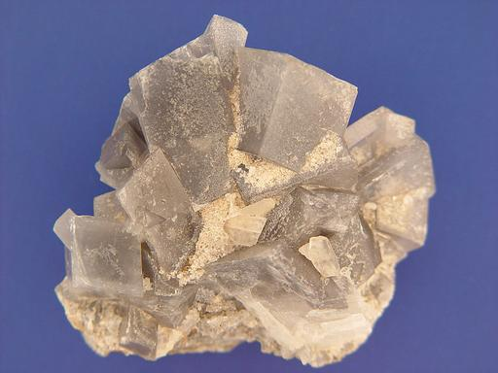
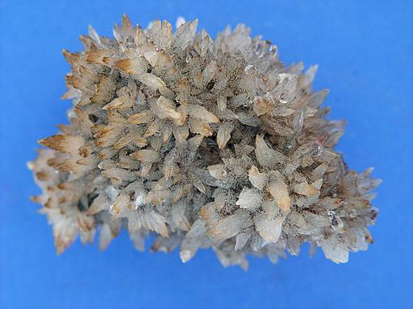
Carbonates
Carbonates are anionic groups of carbon and oxygen. Carbonate minerals result from bonds between these complexes and alkali earth and some transitional metals.
Common carbonate minerals include calcite (CaCO₃ , calcium carbonate) and dolomite CaMg(CO₃)₂ (calcium/magnesium carbonate).
Dolomite
Calcite

Slide 16
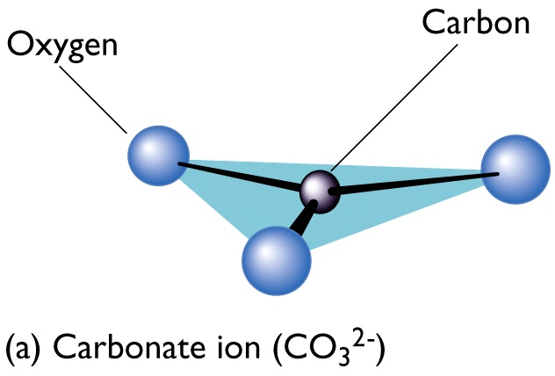
Atomic Structure of Calcium Carbonate (Calcite)

Slide 17
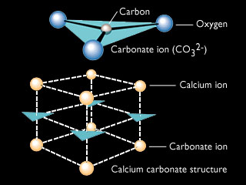
Atomic Structure of Calcium Carbonate (Calcite)

Slide 18
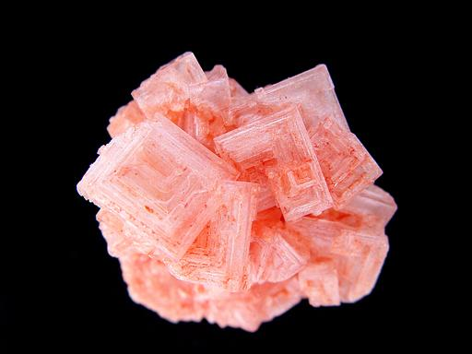
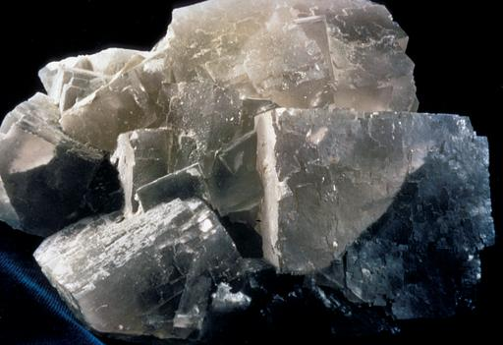
Halides
Halides consist of halogen elements, chlorine (Cl), bromine (Br), fluorine (F), and iodine (I) forming strong ionic bonds with alkali and alkali earth elements sodium (Na), calcium (Ca) and potassium (K)
Some examples include Halite (NaCl) and Flourite (CaF₂).
Halite
Fluorite

Slide 19
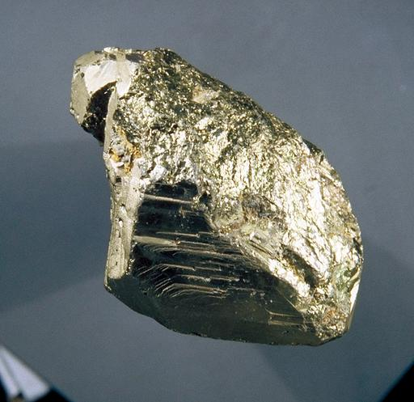
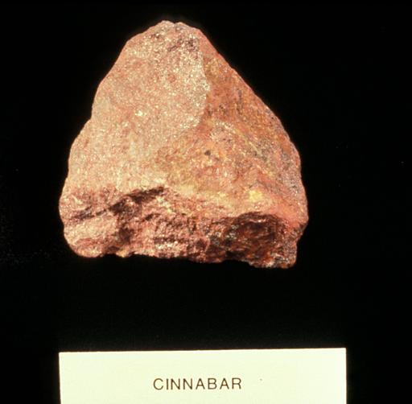
Sulfides
Sulfides are minerals composed of one or more metal cations combined with sulfur. Many sulfides are economically important ores.
Pyrite (FeS₂) or “fool’s gold”, Galena (PbS), Cinnabar (HgS) an Molybdenite (MoS₂) are a few commonly occurring sulfide minerals
Pyrite “Fool’s Gold”
Cinnabar

Slide 20
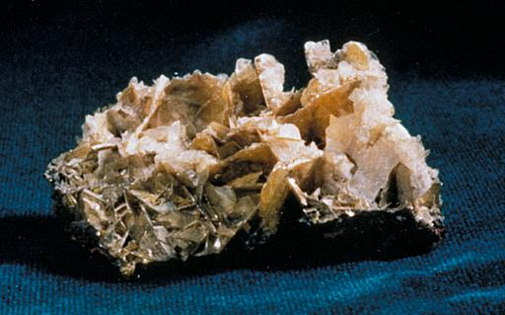
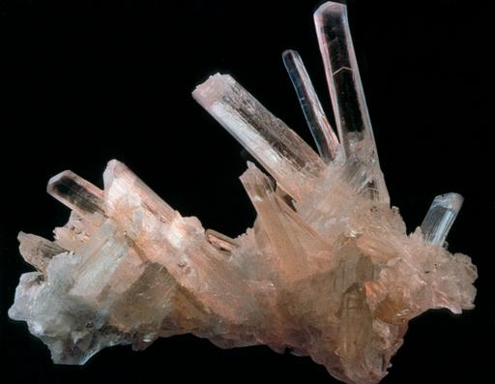
Sulfates
Sulfates are minerals that include SO₄ anionic groups combined with alkali earth and metal cations.
Anhydrous (no water) and hydrous (water) are the two major groups of Sulfates.
Barite (BaSO₄) is an example of a anhydrous sulfate and Gypsum (CaSO_{4 ·} 2H₂O) is an example of a sulfate.
Barite
Gypsum

Slide 21
Silicates
Silicates comprise the majority of minerals in the Earth’s crust and upper mantle. Over 25% of all minerals are included in this group, with over 40% of those accounting for the most common and abundant minerals.
Feldspar, Quartz, Biotite, and Amphibole are the most common silicates

Slide 22
Silica-oxygen tetrahedra
Four oxygens surrounding a silicon ion.
These tetrahedra combine to make the framework of the silicates.
Different combinations produce different structures.

Slide 23
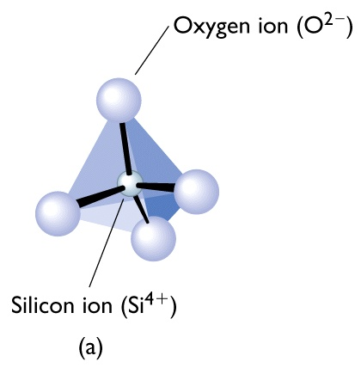
Silicate Ion [SiO₄] ⁴⁺
Silica-oxygen tetrahedra

Slide 24
Silicates
Composed of silicon-oxygen tetrahedrons, an arrangement which contains four oxygen atoms surrounding a silicon atom (SiO₄⁻⁴).
Silicates are divided into two major groups: ferromagnesian silicates and non-ferromagnesian silicates
Ferromagnesian silicates contain iron or magnesium ions joined to the silicate structure. They are darker and have a heavier specific gravity than non-ferromagnesian silicate minerals.
Ferromagnesians include minerals such as olivine, pyroxene, hornblende, and biotite
Non-ferromagnesians include muscovite, feldspar, and quartz

Slide 25
Structure of silicates
Isolated tetrahedrons
Chain silicates
Sheet silicates
Framework silicates

Slide 26

Structure of silicates
Isolated tetrahedrons (e.g., Olivine)

Slide 27
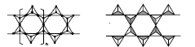
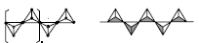
Structure of silicates
Chain silicates (e.g., pyroxenes and amphiboles)
Single chain: Two oxygen ions of each tetrahedra bond to adjacent tetrahedra
Double chain: Two single chains will combine to form double chains linked to each other by shared oxygen ions
Single chain
Double chain

Slide 28
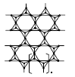
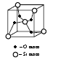
Structure of silicates
Sheet silicates (e.g., Talc)
Frame work silicates (e.g., Quartz)
Three oxygen ions of each tetrahedra bond to adjacent tetrahedra
Each tetrahedra share all its oxygen ions

Slide 29
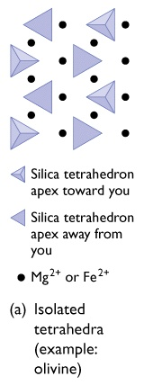
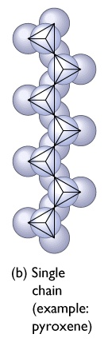
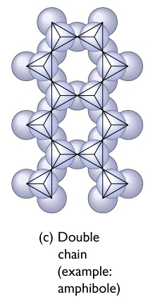

Slide 30
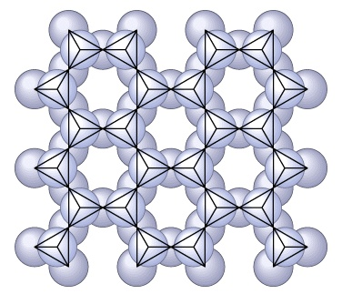
Sheet Silicate (example: mica)

Slide 31
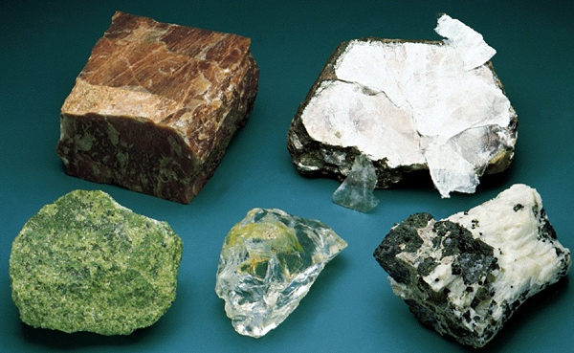
Silicate minerals
Mica
Feldspar
Olivine
Pyroxene
Quartz

Slide 32
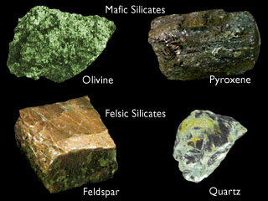
Silicate minerals
Chip Clark

Slide 33
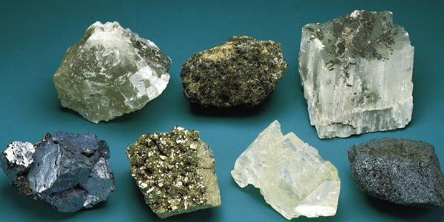
Non-silicate minerals
Spinel
Halite
Gypsum
Galena
Hematite
Pyrite
Calcite

Slide 34
Important mineral groups
Name Important constituents
(other than O)
Olivine Si, Fe, Mg
Pyroxene Si, Fe, Mg, Ca
Amphibole Si, Ca, Mg, Fe, Na, K
Micas Si, Al, K, Fe, Mg
Feldspars Si, Al, Ca, Na, K
Carbonates C, Ca, Mg
Evaporites K, Cl, Ca, S

Slide 35
Physical properties of Minerals

Slide 36
Mineral identification
Crystal form
Hardness
Cleavage
Fracture
Luster
Density
Color
Streak

Slide 37
Crystal form or habit
The external morphology of crystals generally reflect the internal arrangement of their constituent atoms.
This can be obscured, however, if the mineral crystallized in an environment that did not allow it to grow without significant interaction with other crystals (even of the same mineral).

Slide 38
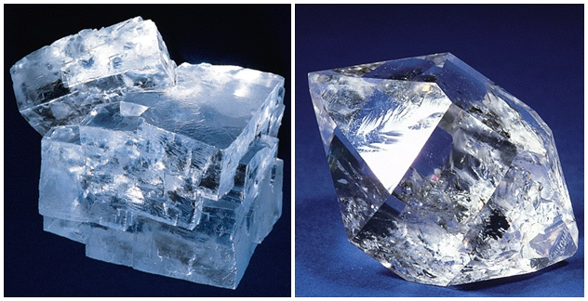
Halite (cubic) and Quartz (hexagonal)

Slide 39
Hardness
How easy it is to scratch a mineral
Mohs Scale of Hardness
Relative scale consists of 10 minerals- ranked 1 (softest) to 10 (hardest)

Slide 40
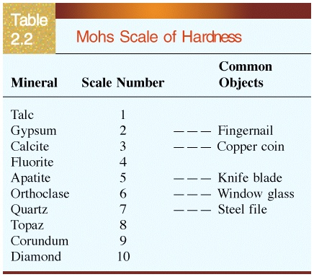

Slide 41
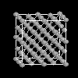
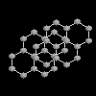
Diamond vs. Graphite crystal structures
Hardness: 10
Hardness: 1-2

Slide 42
Cleavage
The tendency of minerals to split along planar surfaces
The term cleavage is also used to describe the geometric pattern produced by such breakage
Cleavage varies inversely with bond strength; strong bond
generally produce poor or no cleavage

Slide 43
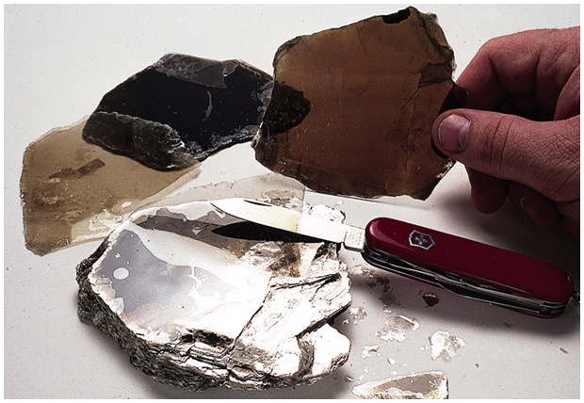
“Sheety” cleavage of mica

Slide 44
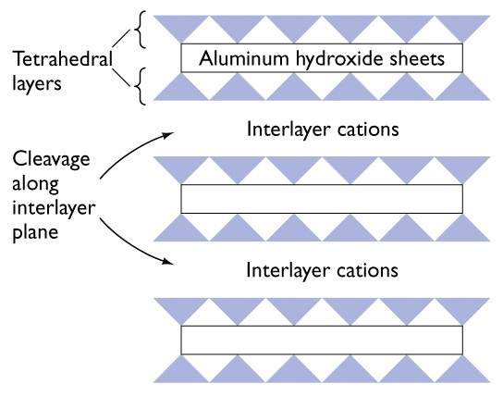
Atomic Structure of Micas

Slide 45
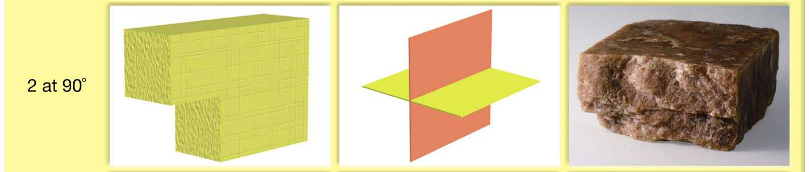
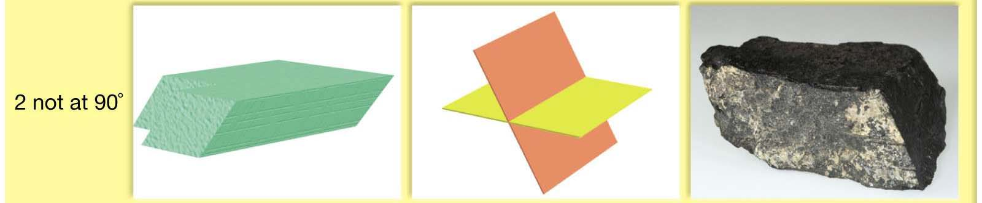
Comparison of cleavage and crystal faces
orthoclase
amphibole

Slide 46
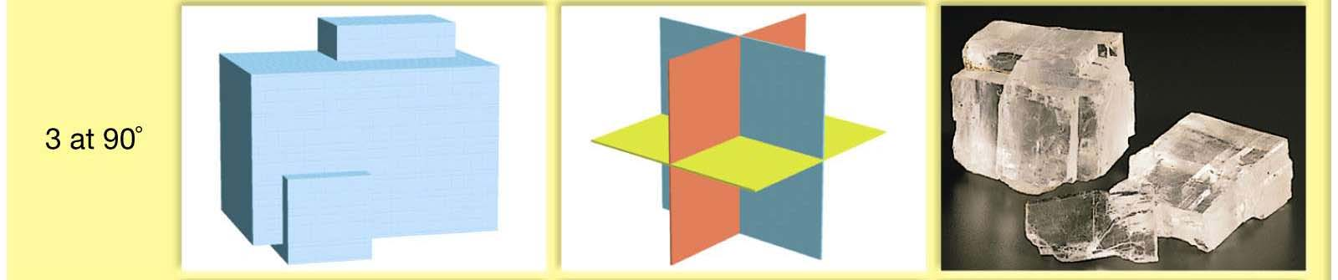
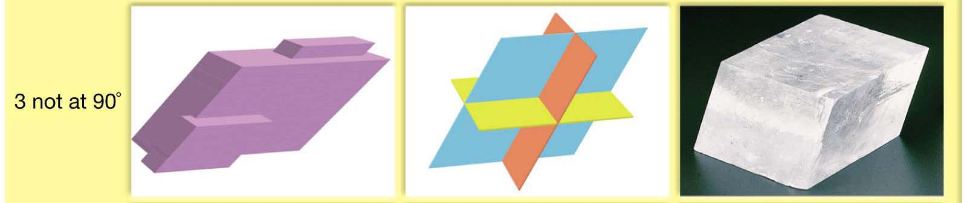
Cleavage (3 directions)
halite
calcite

Slide 47
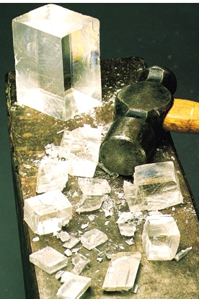
Rhomboidal cleavage of calcite

Slide 48
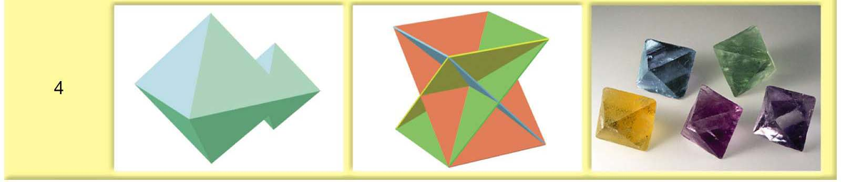
Cleavage (4 directions)
fluorite

Slide 49
Fracture
The tendency of crystals to break along irregular surfaces other than clevages
The fracture is related to how bond strength are distributed in direction
Concoidal fracture: Showing smooth curved surfaces
Fibrous or Splintery: Appearance like split wood

Slide 50
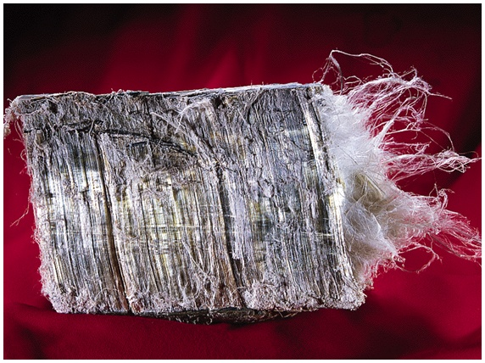
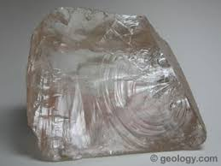
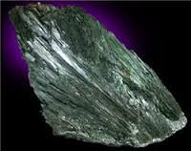
Fracture
Chrysotile (a form of asbestos)
Quartz
Actinolite

Slide 51
Luster
The way the surface of the mineral reflects light give it a characteristic luster
Luster is controlled by kind of atoms present and their bonding which
affect the way light passes through or reflected

Slide 52
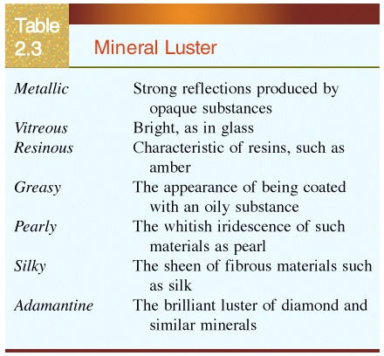
Luster

Slide 53
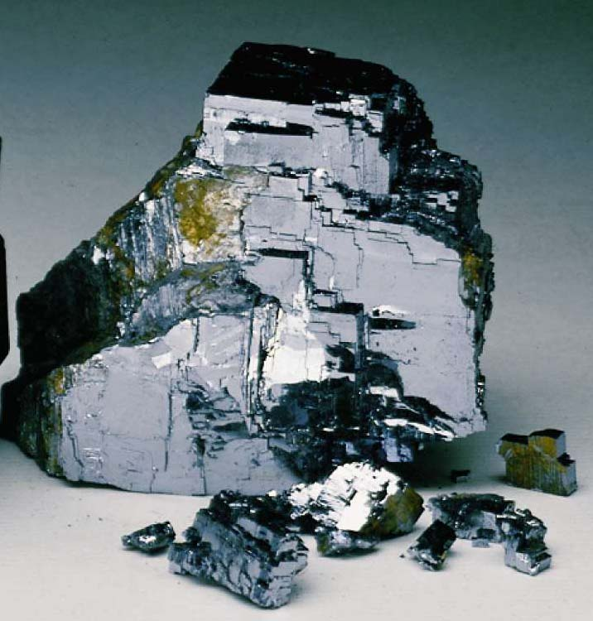
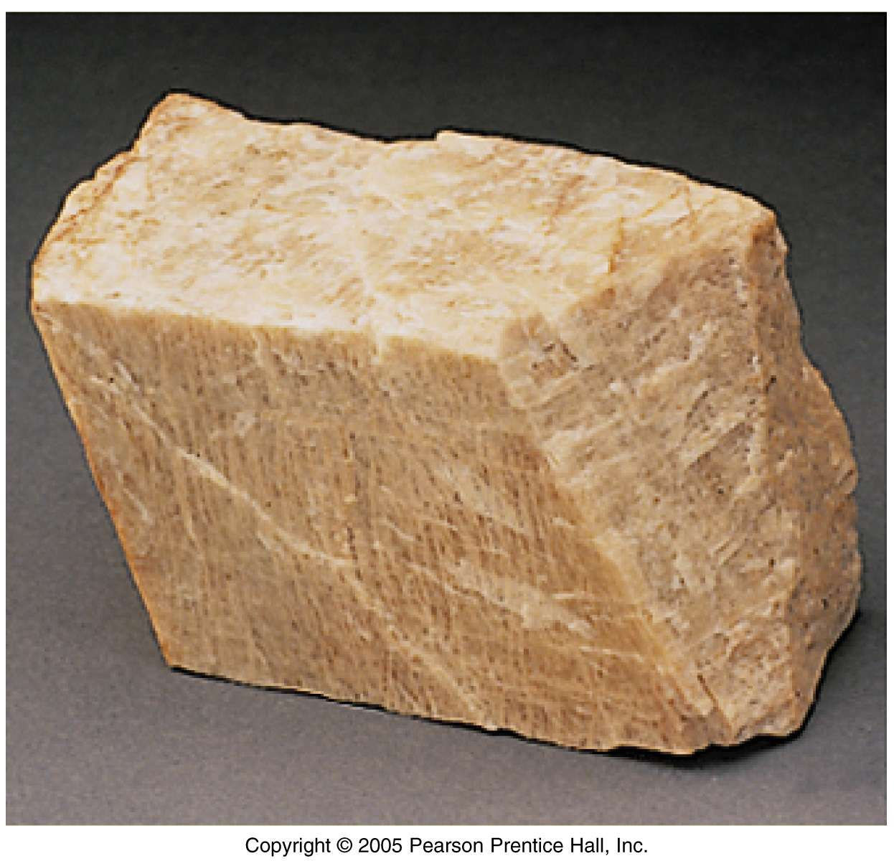


Luster
Metallic
example:
Galena
Non-metallic
example:
Orthoclase
Halite :
Non-Metallic Translucent Luster
Sulfur :
Non-Metallic Waxy Luster

Slide 54
Density and specific gravity
Density - Defined as the mass divided by the volume and normally designated by the Greek letter, rho, ρ.
mass/volume; SI units: kg/m³ or kg m⁻³, but geologists often use g/cm³ as the unit of choice.
Specific Gravity - Ratio of the mass of a substance to the mass of an equal volume of water. S.G. is unitless.
Examples - quartz (SiO₂) has a S.G. of 2.65 while galena (PbS) has a S.G. of 7.5 and gold (Au) has a S.G. of 19.3.

Slide 55
Color
Color arises due to electronic transitions, often of trace constituents, in the visible range of the EM spectrum.
e.g., quartz is found in a variety of colors.
Color of a mineral may be quite diagnostic for the trace element and coordination number of its bonding environment.

Slide 56



Color
Rosy quartz
Milky quartz
Citrine

Slide 57
Color and density
Two broad categories are ferromagnesian and nonferromagnesian silicates.
Ferromagnesian silicates - dark color, density range from 3.2 - 3.6
Olivine - high T, low silica rocks; comprises over 50% of upper mantle
Pyroxenes - high T, low silica rocks
Amphiboles - esp. hornblende; moderate T, higher silica rocks
Mica - esp. biotite; moderate T, higher silica rocks
Garnet - common metamorphic mineral

Slide 58
Color and density
Nonferromagnesian silicates - light color, density close to 2.7
Mica - esp. muscovite; moderate T, higher silica rocks
Feldspars - plagioclase and orthoclase; most common mineral in crust; form over a wide range of temperatures and melt compositions
Quartz - low T, high silica rocks; extremely stable at surface, hence it tends to be a major component in sedimentary rocks.
Clay - esp. kaolinite; different types found in different soils

Slide 59
Streak
Streak refers to the color of a mineral’s powdered form left behind after it is scraped or rubbed across a porcelain streak plate.
A mineral may appear one color and then produce a streak with a different color.
A mineral’s streak color is a more reliable identification characteristic than the minerals perceived surface color.

Slide 60

Streak
Hematite

Slide 61

Streak
Mineral pyrite is gold in color, it leaves a grey “pencil lead” streak on the porcelain streak plate

Slide 62
Distinctive properties
reaction with hydrochloric acid (calcite fizzes)
taste (halite tastes salty)
feel (talc feels soapy, graphite feels greasy)
magnetism (magnetite attracts a magnet)
double refraction (calcite when placed over printed material, letters appear doubled)
smell (sulfur smells like rotten eggs)

Slide 63

Calcite passes the “acid test”

Slide 64


Slide 65
Polymorphs
Minerals with the same chemical composition but different structure.
e.g., diamond and graphite
andalusite, kyanite, and sillimanite

Slide 66

Graphite
Atomic Structure Crystal Form
Ken Lucas, Visuals Unlimited

Slide 67

Diamond
Atomic Structure Crystal Form
E.R. Degginger, Photo Researchers

Slide 68
Rocks
A naturally occurring consolidated mixture of minerals or mineral-like substances
Rocks can be also made up of non mineral matter (e.g., obsidian and coal)
The identity of rock is determined partly by its mineral and partly by its texture.

Slide 69

Rocks

Slide 70
Texture
Texture describes size and shapes of a rocks mineral crystals or grains.
The grain large enough to be seen the rock is classified as coarse grained.
The grain not large enough to be seen the rock is classified as fine grained.

Slide 71
Rocks
Rocks formed by solidification of molten rock are called igneous rock
Weathering and erosion of rocks exposed at the surface – sedimentary rocks
Rocks formed under high pressure and temperature in deep crust and upper mantle is metamorphic rocks

Slide 72

Rocks

Slide 73

Rocks

Slide 74

Igneous Rocks

Slide 75
IDC203: IDC:203: Introduction to Earth Sciences

